Slide 1
Wine Quality Classification
IMLP439/蘇家平
2025/04

Slide 2
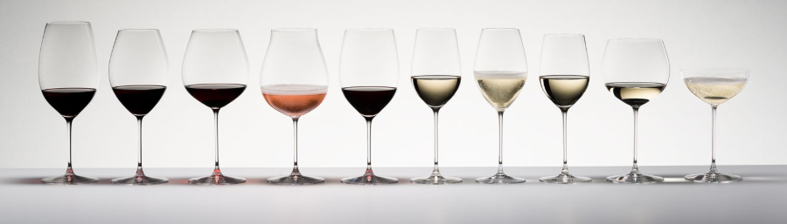
Wine Quality Dataset
This datasets is related to red variants of the Portuguese “Vinho Verde” wine. The dataset describes the amount of various chemicals present in wine and their effect on it‘s quality. The classes are ordered and not balanced (e.g. there are much more normal wines than excellent or poor ones). Task is to predict the quality of wine using the given data.
https://www.kaggle.com/datasets/yasserh/wine-quality-dataset/data

Slide 3
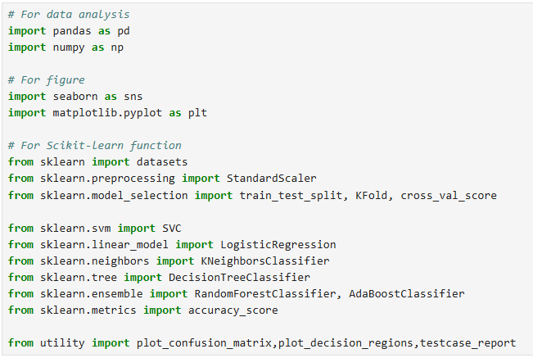
0. Import functions

Slide 4
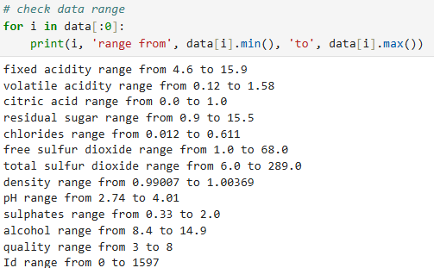

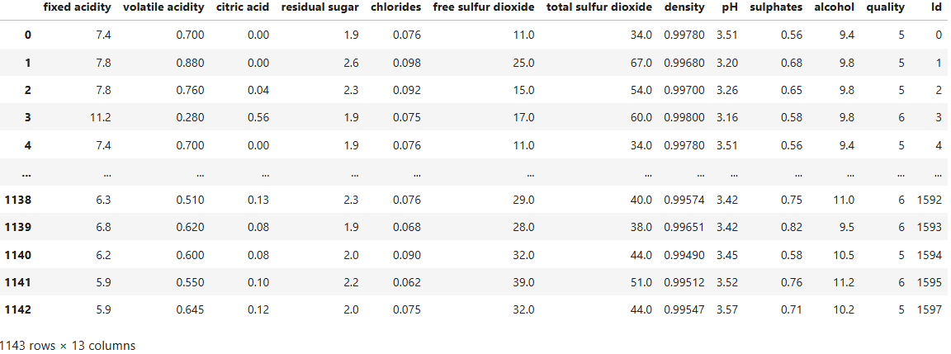
1. Collect and clean data (1/3)
This data frame contains:
11 columns of chemical items
1 column of quality score (3~8)
1 column of wine ID
固定酸度
揮發性酸度
檸檬酸
殘糖
氯化物
遊離二氧化硫
總二氧化硫
密度
pH值
硫酸鹽
酒精

Slide 5
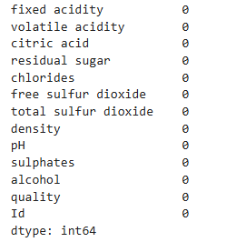

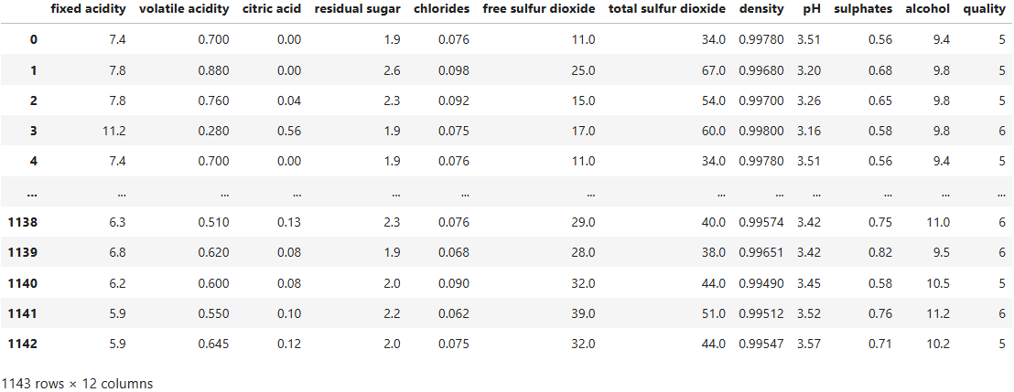
1. Collect and clean data (2/3)
This dataset is clear.
However, the feature 'Id' is not useful, and we will drop it.

Slide 6
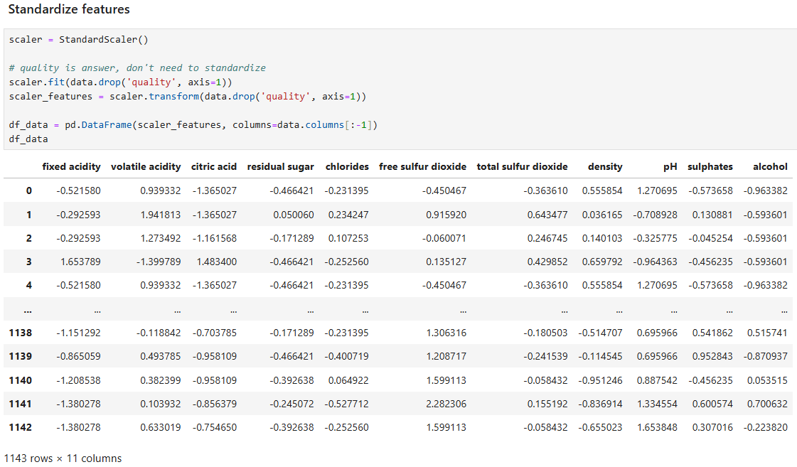
1. Collect and clean data (3/3)
Standardize all features

Slide 7
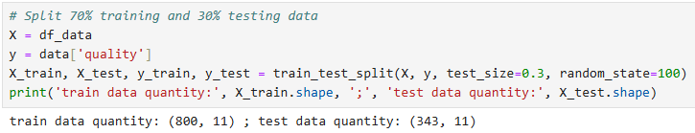
2. Train through various models
Split 70% training and 30% testing data

Slide 8
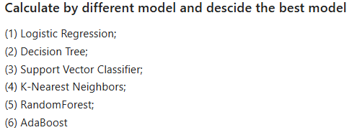
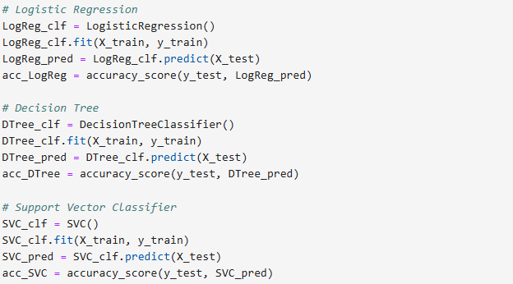
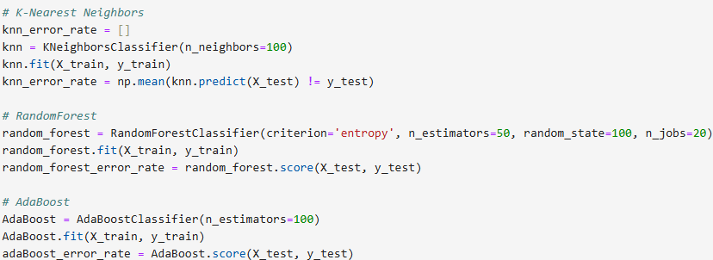
2. Train through various models (1/2)

Slide 9
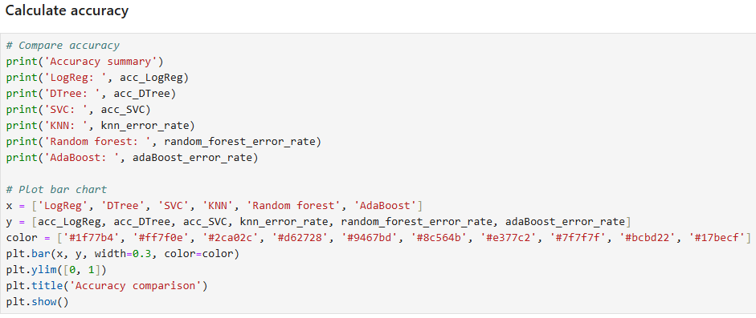
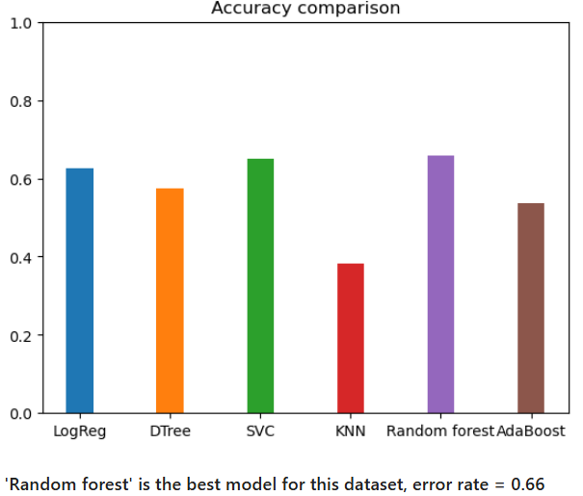
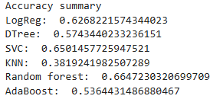
2. Train through various models (2/2)
'Random forest' is the best model for this dataset, error rate = 0.66

Slide 10
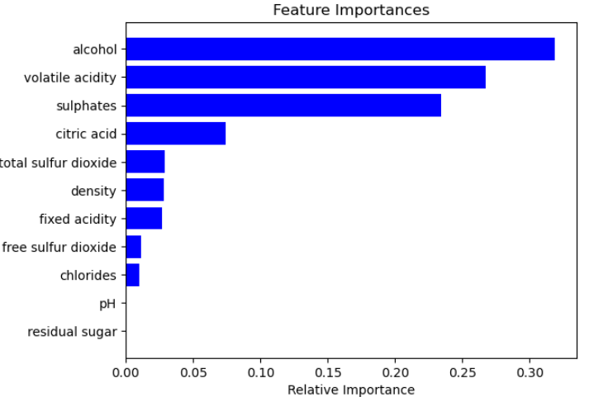
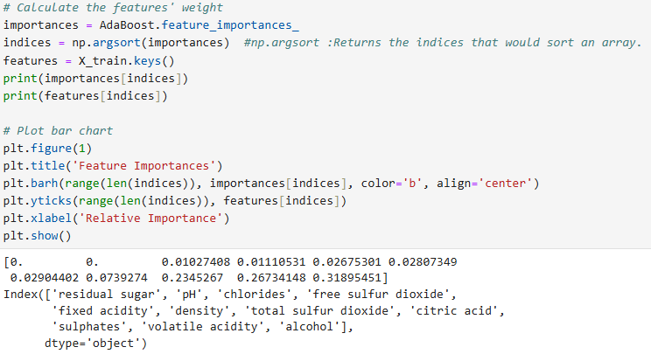
3. Analysis the top 3 important items (1/2)
alcohol (0.32), volatile acidity (0.27), and sulphates (0.23) are the top 3 important items

Slide 11
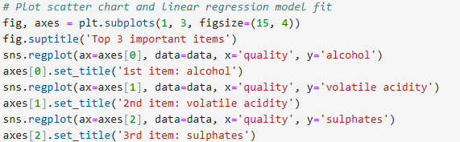
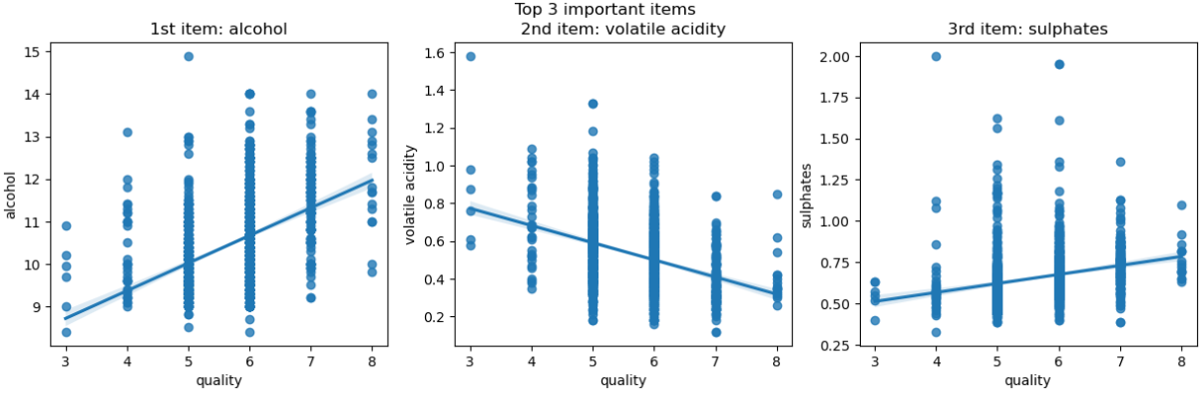
3. Analysis the top 3 important items (2/2)

Slide 12
4. Conclusion
According to our statistical results, good red wine is likely to have higher alcohol content, lower volatile acidity and higher sulfate content.

